Slide 1




Recent Trends in the U. S. Digital Assets Regulation and International Regulatory Cooperation Strategies
Dae Chung(Ph.D. in Law, a professor of law, Division of Maritime Law, Nat’l Korea Maritime & Ocean University)

Slide 2
Table of Contents
Introduction Current Situations of Digital Assets Regulation Legislative Situations of Digital Assets Regulation International Cooperation Strategies on Digital Assets Regulation Conclusion

Slide 3

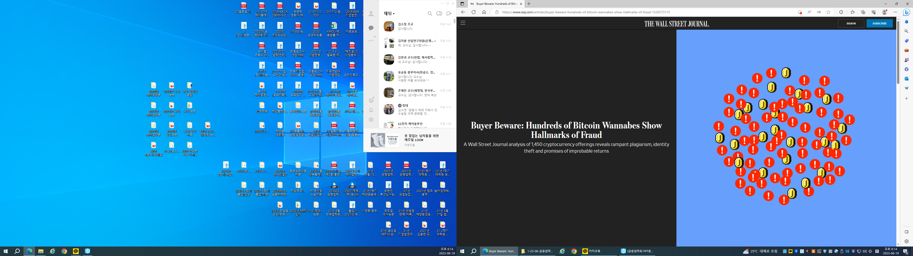
I. Introduction
On May 17, 2018 the Wall Street Journal analysis of 1,450 cryptocurrency offerings reveals rampant plagiarism, identity theft and promises of improbable returns.

Slide 4

I. Introduction
On November 8, 2021 the cryptocurrency market rushed out $3 trillion in combined value Monday morning.

Slide 5
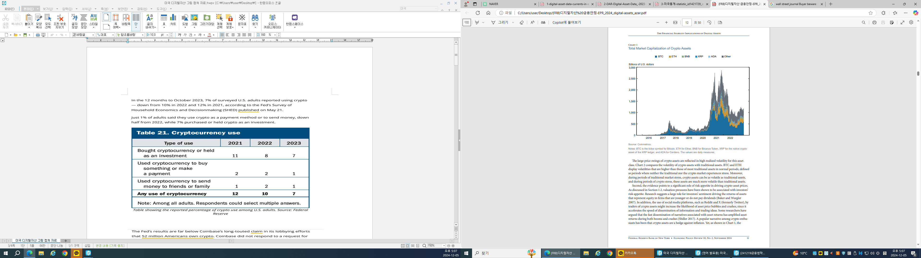
I. Introduction
The main financial vulnerability from crypto assets corresponds to the buildup of valuation pressures. Valuation pressures in crypto assets are underscored by the recurrent large declines in the price of BTC and other crypto assets.

Slide 6
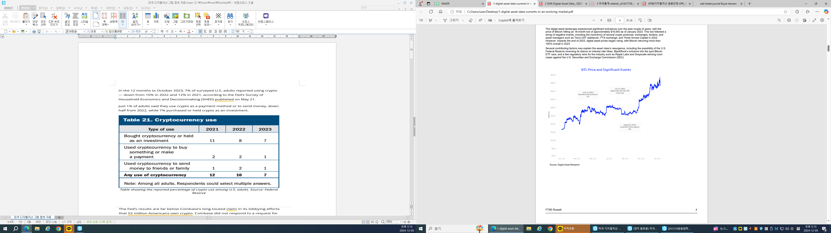
I. Introduction
In 2023, BTC price has gradually increased according to significants events.

Slide 7
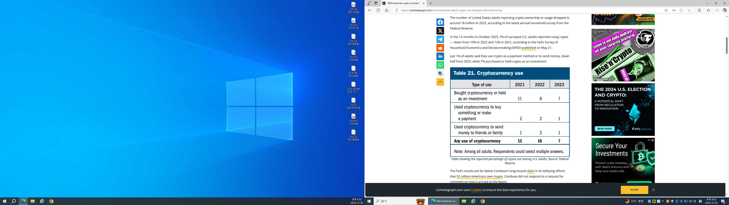
I. Introduction
In the 12 months to October 2023, 7% of surveyed U. S. adults reported using crypto-down from 10% in 2022 and 12% in 2021(The Fed’s Survey of Household Economics and Decisionmaking on May 21, 2023). Just 1% of adults said that they use crypto as a payment method or to send money, down half from 2022, while 7% purchased or held crypto as an investment.

Slide 8
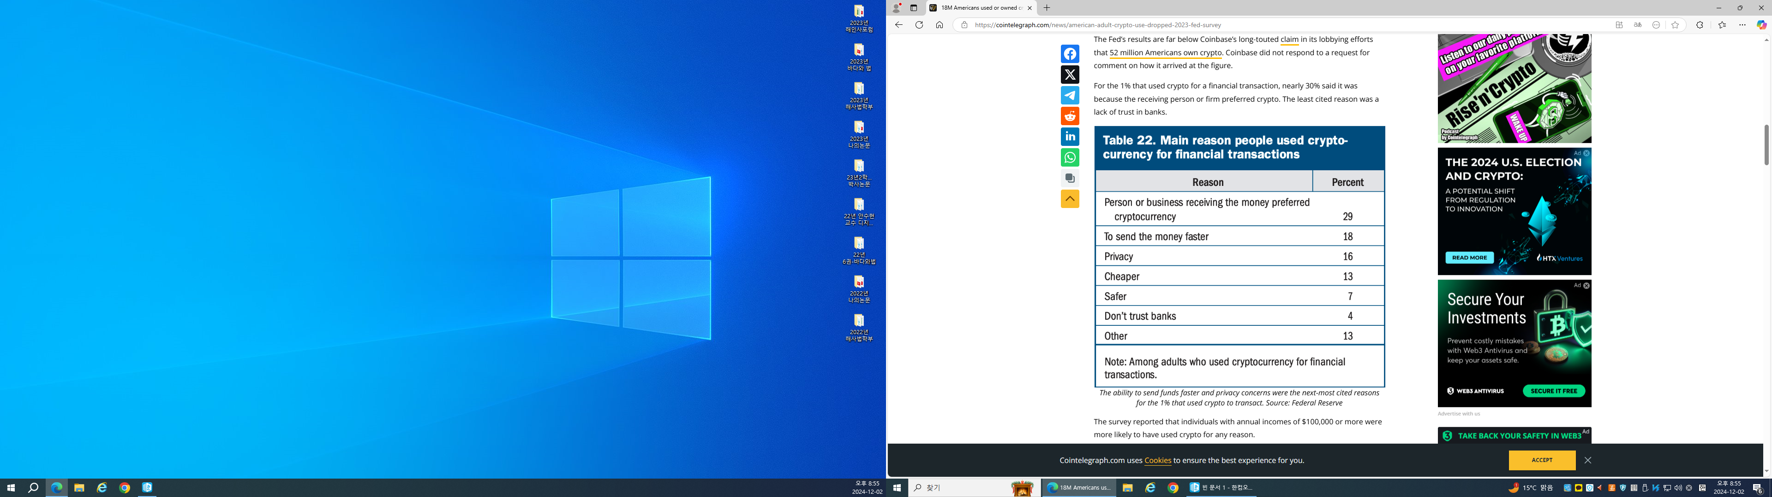
I. Introduction
For the 1% that used crypto for a financial transaction, nearly 30% said it was because the receiving person or firm preferred crypto. The least cited reason was a lack of trust in banks. The survey reported that individuals with annual income of $ 100,000 or more were more likely to have used crypto for any reason.

Slide 9
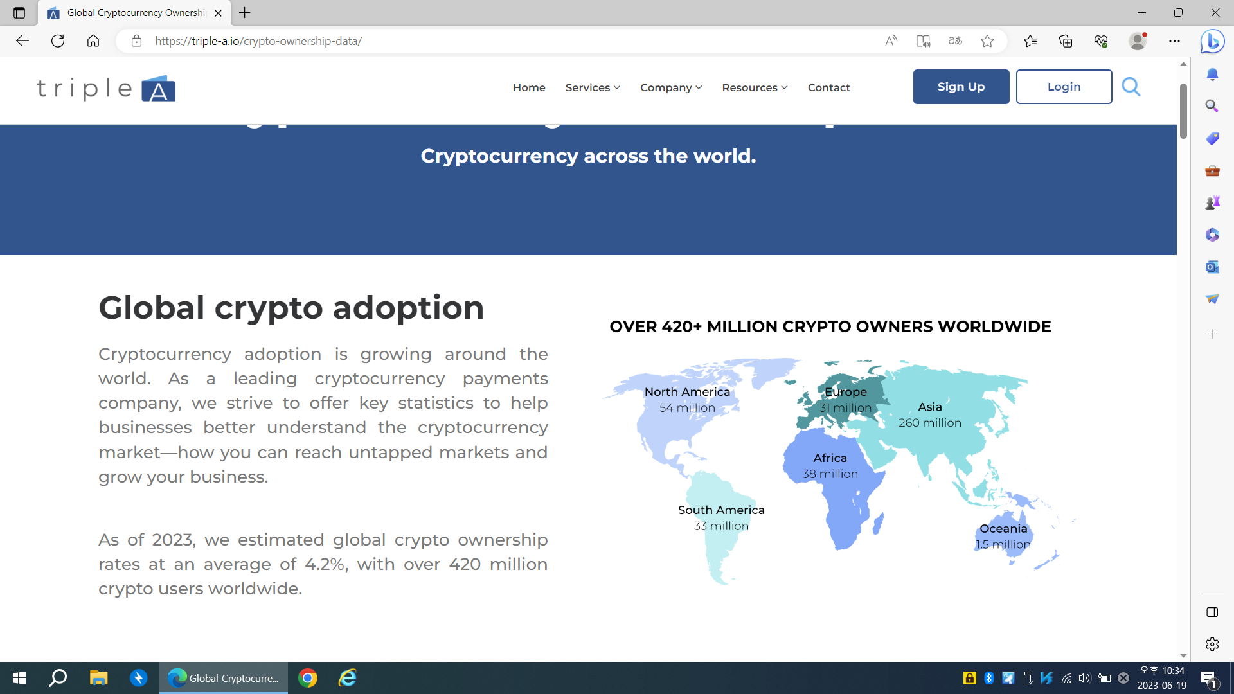
I. Introduction
According to Triple-A, as of May 2023, there are 420 million people holding cryptocurrency worldwide, with Asia having the largest number of cryptocurrency holders at 260 million.

Slide 10
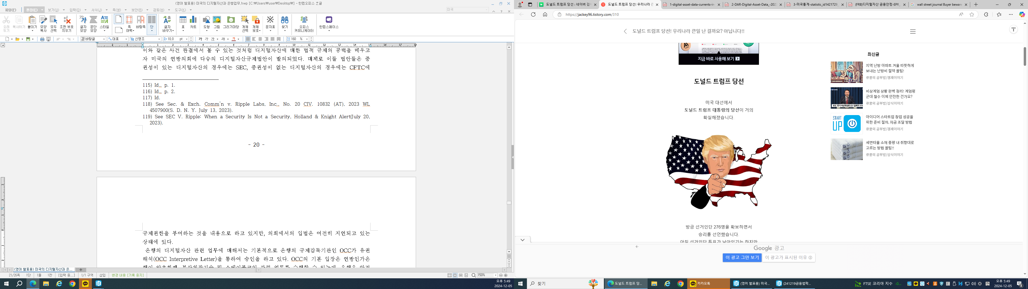
I. Introduction
With Donald Trump being elected as the 47th President of the United States in 2024,
the prices of digital assets such as Bitcoin are on the rise.

Slide 11
II. Current Situations of Digital Assets Regulation
Regulatory Institutions of Digital Assets
Financial Crimes Enforcement Network(FinCEN)
① An agency under the U. S. Treasury Department
② Preventing money laundering and concealment of criminal proceeds under the Bank
Secrecy Act(BSA)
③ FinCEN, Application of FinCEN’s Regulations to Persons Administering, Exchanging, or
Using Virtual Currencies(Mar. 18, 2013)
④ FinCEN, Application of FinCEN’s Regulations to Certain Business Models Involving
Convertible Virtual Currencies(May 9, 2019)

Slide 12
II. Current Situations of Digital Assets Regulation
(2) Department of Justice(DOJ)
On October 6, 2021 DOJ established National Cryptocurrency Enforcement Team(NCET) in order to prevent cryptocurrency from being used for criminal activities.
(3) Securities and Exchange Commission(SEC)
① In 2019, SEC : Framework for ‘Investment Contract’Analysis of Digital Assets
② Reuters, U.S. SEC Official Says Ether Not a Security, Price Surges(Jun. 14, 2018)
SEC v. W. J. Howey Co., 328 U. S. 293 (1946) ① The Investment of Money ② Common Enterprise ③ Reasonable Expectation of Profits Derived from the Efforts of Others

Slide 13
II. Current Situations of Digital Assets Regulation
(4) Commodity Futures Trading Commission(CFTC)
① The CFTC regulates derivatives markets such as futures, forwards, options, and swaps
under the Commodity Exchange Act (CEA).
② Digital assets are also considered commodities under the Commodity Exchange Act(7
U.S.C. §1 a (9)).
③ In 2015, the CFTC found: “Bitcoin and other virtual currencies are encompassed in the
[commodity] definition and properly defined as commodities.” See In the Matter of:
Coinflip, Inc., d/b/a Derivabit, and Francisco Riordan, CFTC Docket No. 15-19[CFTC,
Digital Asset Primer(December 2020)]

Slide 14
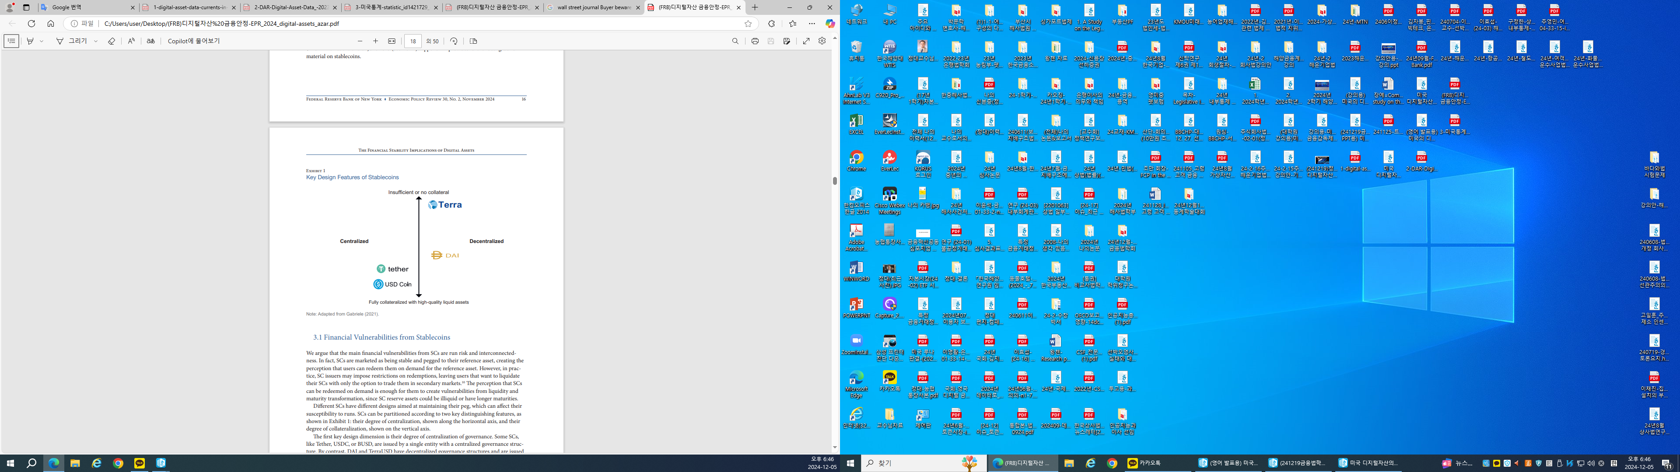
II. Current Situations of Digital Assets Regulation
2. Regulation of Stablecoins

Slide 15
II. Current Situations of Digital Assets Regulation
① Stablecoins are marketed as being stable and pegged to their reference asset. Key
design features of Stablecoins are the degree of centralization of governance and the
degree of collateralization. The main financial vulnerabilities from stablecoins are run
risk and interconnectedness.
② On November 11, 2021 FDIC·OCC·President’s Working Group on Financial
Markets(PWG) → Report on Stablecoins
Report on Stablecoins recommends advancing rapid federal legislation on stablecoins, and requires stablecoin issuers to be insured depository institutions to prevent stablecoin runs and address risks to stablecoin users.

Slide 16
II. Current Situations of Digital Assets Regulation
3. President Joe Biden : Executive Order on Ensuring Responsible
Development of Digital Assets(March 09, 2022)
<The Principal Policy Objectives of U. S.>
(1) We must protect consumers, investors, and businesses in U. S.
(2) We must protect U. S. and global financial stability and mitigate systemic risk.
(3) We must mitigate the illicit finance and national security risks posed by misuse of
digital assets.

Slide 17
II. Current Situations of Digital Assets Regulation
(4) We must reinforce U. S. leadership in the global financial system and in technological and economic competitiveness, including through the responsible development of payment innovations and digital assets.
(5) We must promote access to safe and affordable financial services.
(6) We must support technological advances that promote responsible development and use of digital assets.

Slide 18
II. Current Situations of Digital Assets Regulation
4. Recent Case Law on Digital Assets
(1) SEC v. Ripple Labs, Inc., No. 20 CIV. 10832(AT), 2023 WL 4507900(S. D. N. Y. July 13, 2023)
Plaintiff, the Securities and Exchange Commission (the “SEC”), brings this action against Defendants Ripple Labs, Inc. (“Ripple”) and two of its senior leaders, Bradley Garlinghouse and Christian A. Larsen, alleging that Defendants engaged in the unlawful offer and sale of securities
in violation of Section 5 of the Securities Act of 1933

Slide 19
II. Current Situations of Digital Assets Regulation
① Sales of XRP directly to institutional investors (Institutional Sales)
→ a security under investment contract
② Algorithmic sales of XRP on digital asset trading platforms (Programmatic Sales)
→ XRP token is Not a security

Slide 20
II. Current Situations of Digital Assets Regulation
(2) SEC v. Terraform Labs, 23-cv-1346, Verdict (2024. 4. 5)
The Securities and Exchange Commission (“SEC”) alleges that the defendants -- Terraform Labs Pte. Ltd., a “cryptoꠓassets” company, and its founder, Do Hyeong Kwon –- orchestrated a multi-billion-dollar fraud involving the development, marketing, and sale of various cryptocurrencies. The SEC’s claims, all brought under the federal securities laws, include a claim that defendants offered and sold unregistered securities, claims that defendants offered and effected transactions in unregistered security-based swaps, and claims that defendants engaged in fraudulent schemes to lead investors astray.
LUNA → a security under investment contract

Slide 21
III. Legislative Situations of Digital Assets Regulation
Federal Level
Digital Asset Market Structure and Investor Protection Act of 2021
1) Press Releases: Beyer Introduces New Legislation To Regulate Digital Assets(July 28, 2021)
2) On July 28, 2021, Rep. Don Beyer (D-CA) introduced the Digital Asset Market Structure and Investor Protection Act, which aims to promote financial innovation and protect investors by including digital assets within the current financial regulatory structure.
3) digital asset → CFTC

Slide 22
III. Legislative Situations of Digital Assets Regulation
4) digital asset securities → SEC
TITLE I-DIGITAL ASSET SECURITIES UNDER THE FEDERAL SECURITIES LAWS TITLE II-TREATMENT OF DIGITAL ASSETS UNDER THE COMMODITY EXCHANGE ACT TITLE III-DIGITAL FEDERAL RESERVE NOTE, LEGAL TENDER STATUS, THE REGULATION OF DIGITAL ASSET FIAT-BASED STABLECOINS, AND FEDERAL DEPOSIT AND SHARE INSURANCE FOR DIGITAL ASSETS TITLE IV-BANK SECRECY ACT TITLE V-VARIOUS DIGITAL ASSET REPORTS

Slide 23
III. Legislative Situations of Digital Assets Regulation
(2) Responsible Financial Innovation Act of 2022
On June 7, 2022, Republican Senator Cynthia Lummis and Democratic Senator Kirsten Gillibrand introduced the Lummis-Gillibrand Responsible Financial Innovation Act, which includes provisions on the legal nature of digital assets, regulatory jurisdiction, and regulation of stablecoins, and aims to alleviate uncertainty in related industries and protect consumers.

Slide 24
III. Legislative Situations of Digital Assets Regulation
TITLE I-DEFINITIONS TITLE II-RESPONSIBLE TAXATION OF DIGITAL ASSETS TITLE III-RESPONSIBLE SECURITIES INNOVATION TITLE IV-RESPONSIBLE COMMODITIES INNOVATION TITLE V-RESPONSIBLE CONSUMER PROTECTION TITLE VI-RESPONSIBLE PAYMENTS INNOVATION TITLE VII-RESPONSIBLE BANKING INNOVATION TITLE VIII-RESPONSIBLE INTERAGENCY COORDINATION
2) Digital Currencies(like bitcoin & ethereum) → Commodity → CFTC(=exclusive jurisdiction)

Slide 25
III. Legislative Situations of Digital Assets Regulation
(3) Digital Commodities Consumer Protection Act of 2022
1) On August 3, 2022, Senators Debbie Stabenow (D-CA) and John Boozman (R-CA)
introduced the Digital Commodities Consumer Protection Act of 2022. The bill seeks to
create a comprehensive oversight framework centered around a newly defined term,
“digital commodity.” The bill explicitly excludes securities from the definition of digital
commodity.
2) digital commodity → CFTC

Slide 26
III. Legislative Situations of Digital Assets Regulation
(4) Stablecoin Transparency of Reserves and Uniform Safe Transactions Act of
2022(Stablecoin TRUST ACT of 2022)
1) On December 21, 2022, Senator Pat Toomey, a Republican on the Senate Banking,
Housing, and Urban Affairs Committee, introduced the “Stablecoin Transparency of
Reserves and Uniform Safe Transactions Act of 2022 (Stablecoin TRUST ACT of 2022).”
2) The bill establishes the first federal regulatory framework for payment stablecoins.
The bill explicitly provides that the Office of the Comptroller of the Currency (OCC) has
regulatory authority over payment stablecoins.

Slide 27
III. Legislative Situations of Digital Assets Regulation
3) The bill creates a new federal license issued by the OCC to issue payment stablecoin
issuers, called “National Limited Payment Stablecoin Issuers.” The bill requires that all
stablecoins be fully collateralized by liquid assets and authorizes multiple types of
regulated entities (e.g., depository institutions, National Limited Payment Stablecoin
Issuers, etc.) to issue stablecoins.

Slide 28
III. Legislative Situations of Digital Assets Regulation
(5) Clarity for Payment Stablecoins Act of 2023
1) The House Committee on Financial Services on July 27, 2023, ordered to be reported
an amendment in the nature of a substitute of the Clarity for Payment Stablecoins Act
(H.R. 4766), sponsored by Chair Patrick McHenry, which would change how stablecoins
are regulated.
2) Currently, there is no comprehensive federal regulatory framework specifically
designed for stablecoins. Instead, existing state and federal laws and regulations are
applied to aspects of the stablecoin industry based on the nature of activities and
individual stablecoin features.
3) The bill would require an issuer to hold at least one dollar of permitted reserves for
every dollar worth of stablecoins outstanding/issued.

Slide 29
III. Legislative Situations of Digital Assets Regulation
4) According to the bill, issuers would be required to establish and disclose stablecoin
redemption procedures and to publish monthly reports on outstanding stablecoins and
reserve composition.
5) The bill would establish a framework for regulation, supervision, and enforcement of
stablecoin issuers. The bill envisions a federal or state option for stablecoin issuers, and
issuers could be banks or nonbanks.

Slide 30
III. Legislative Situations of Digital Assets Regulation
(6) Financial Innovation and Technology for the 21st Century Act of 2024
1) On Friday May 10, the House Committee on Rules publicly noticed its intent to
consider H.R. 4763, the Financial Innovation and Technology for the 21st Century Act
(FIT21), which could lead to a floor vote later this month. The bill, as amended, would
introduce significant changes to the way digital assets are regulated. Currently, various
existing laws and regulations may apply to digital assets—including those administered
by the Securities and Exchange Commission (SEC) and the Commodity Futures Trading
Commission (CFTC)—depending on the specific circumstances.
2) The bill would create specific classification criteria to determine whether a particular
digital asset should be regulated by the SEC, by the CFTC, or both, and would establish
new regulatory requirements based on how a digital asset is classified.

Slide 31
III. Legislative Situations of Digital Assets Regulation
3) The bill would classify a digital asset as a digital commodity, regulated by the CFTC, if
the blockchain(digital ledger) on which it runs is certified as decentralized.
4) By explicitly classifying decentralized digital assets as digital commodities, the bill
would grant CFTC new authorities, providing it exclusive jurisdiction over “cash” or
“spot” market digital commodity transactions, and requiring that entities (including
exchanges, brokers, dealers, etc.) offering trade in digital commodities register with it.
5) The bill would prohibit platforms from comingling their own funds with those of
customers but would permit a customer to waive this for certain reasons.
6) Digital assets that run on blockchains that are not decentralized would, depending on
certain characteristics, be classified as restricted digital assets or securities, regulated
by the SEC.

Slide 32
III. Legislative Situations of Digital Assets Regulation
2. Regulatory Sandboxes at the State and Federal Levels
State Level
Several states have regulatory sandbox programmes that can benefit blockchain initiatives, including Arizona, Florida, Hawaii, Nevada, North Carolina, Utah, West
Virginia and Wyoming.
(2) Federal Level
On a federal level, the Consumer Financial Protection Bureau (CFPB) introduced a digital sandbox to encourage innovation in financial products and services.

Slide 33
IV. International Cooperation Strategies on Digital Assets Regulation
International Regulatory Status on Digital Assets
European Union’s Market in Crypto Asset Regulations (MiCA) (in June 2023)
The European Union’s Market in Crypto Asset Regulations (MiCA) is intended to address consumer protection, market transparency, and operational standards for crypto-asset service providers and issuers within the European Union.
(2) International Monetary Fund(IMF) (in July 2023)
The International Monetary Fund issued a working paper on “Taxing Cryptocurrencies” which delves into issues for consideration relevant to the development of a tax regime for crypto assets.
Crypto taxation laws : Italy(the Budget Law 2023), Portuguese Personal Income Tax Code, Brazil(new income tax regulations for the payment of taxes in relation to earnings obtained from crypto assets)

Slide 34
IV. International Cooperation Strategies on Digital Assets Regulation
(3) Financial Stability Board(FSB) (in July 2023)
[ Report : high-level recommendations on the global regulatory framework for crypto-asset activities]
① the regulatory powers and tools that should be available to authorities for the supervision of crypto asset activities
② the need for a comprehensive regulatory framework
③ cross border cooperation, coordination and information sharing,
④(d) governance

Slide 35
IV. International Cooperation Strategies on Digital Assets Regulation
⑤ risk management
⑥ data collection (including recording and reporting)
⑦ disclosures
⑧ financial stability risks as it relates to interconnections and interdependencies
⑨ comprehensive regulation of crypto-asset service providers with multiple functions

Slide 36
IV. International Cooperation Strategies on Digital Assets Regulation
(4) International Organization of Securities Commissions (IOSCO) (in November 2023)
[Report : policy recommendations for Crypto and Digital Asset Markets]
① conflicts of interest
② market manipulation, insider trading and fraud
③ cross-border risks and regulatory co-operation
④ custody and client asset protection
⑤ operational and technological risk
⑥ retail access, suitability, and distribution

Slide 37
IV. International Cooperation Strategies on Digital Assets Regulation
(5) World Economic Forum (in October 2024)
[Report : Digital Assets Regulation: Insights from Jurisdictional Approaches] → Recommendations
① Anti-Money Laundering(AML) & Know Your Customer (KYC)
② Regulatory & Technical Sandbox
③ Decentralized Finance(DeFi)
④ Privacy & Security Policy
→ Global Cooperation

Slide 38
IV. International Cooperation Strategies on Digital Assets Regulation
2. US Treasury & Justice
Treasury
DOT conduct meeting of US-UK Financial Regulatory Working Group.
→ The Working Group meeting focused on several key themes including digital assets, and maintained the importance of comprehensive regulation in the area of digital finance, as well as its commitment to fostering responsible digital financial innovation, including through the parallel bilateral Financial Innovation Partnership.
(2) Justice
DOJ calls for corporate compliance programs to evolve to meet the threat of “cryptocrime.”

Slide 39
V. Conclusion
Korea – Cambodia Digital Assets Regulation Working Group
There is a need to establish “a task force for digital asset regulation between the Korean and Cambodian governments” to form a partnership for regulatory efforts.
(1) Anti-Money Laundering(AML) & Know Your Customer (KYC)
(2) Regulatory & Technological Sandboxes
(3) Privacy & Security Policy → To protect financial consumers
Korea : Act on the Protection of Virtual Asset Users (Effective July 19, 2024)

Slide 40
Thank You !!!

Slide 41
[References]
Congressional Research Service, An Overview of H.R. 4763, Financial Innovation and Technology for the 21st Century Act, CRS INSIGHT, 2024.
Congressional Research Service, An Overview of H.R. 4766, Clarity for Payment Stablecoins Act, CRS INSIGHT, 2023.
Dae Chung, Trend of Regulation on Digital Assets and Digital Assets-related Activities of National Banks in USA, Korean Journal of Financial Law, 20(3), 2023.
Digital Asset Research, Digital asset data: Currents in an evolving market, FTSE RUSSELL, 2024.
Executive Order on Ensuring Responsible Development of Digital Assets, March 09, 2022.
Federal Reserve Bank of New York, The Financial Stability Implications of Digital Assets, Economic Policy Review, Vol. 30, No. 2, 2024.
World Economic Forum, Digital Assets Regulation: Insights from Jurisdictional Approaches, Insight Report, 2024.

